Slide 1




Tutorial for this week
TA Pan
2022/04/12

Slide 2

Basic MySQL Review
1
Exercises
2

Slide 3
Basic MySQL Review

Slide 4
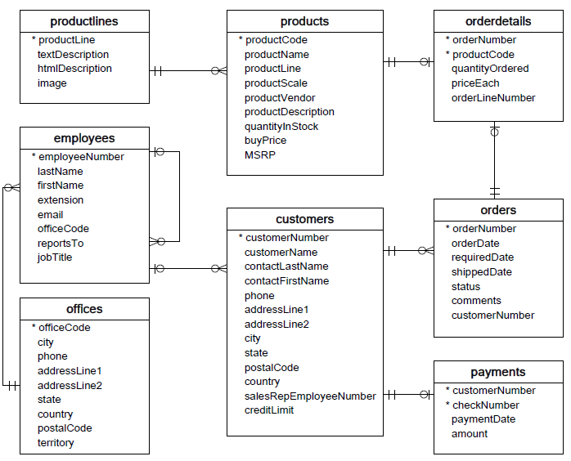
01
Sample Database

Slide 5
01
Sample Database
Customers: stores customer’s data.
Products: stores a list of scale model cars.
ProductLines: stores a list of product line categories.
Orders: stores sales orders placed by customers.
OrderDetails: stores sales order line items for each sales order.
Payments: stores payments made by customers based on their accounts.
Employees: stores all employee information as well as the organization structure such as who reports to whom.
Offices: stores sales office data.

Slide 6
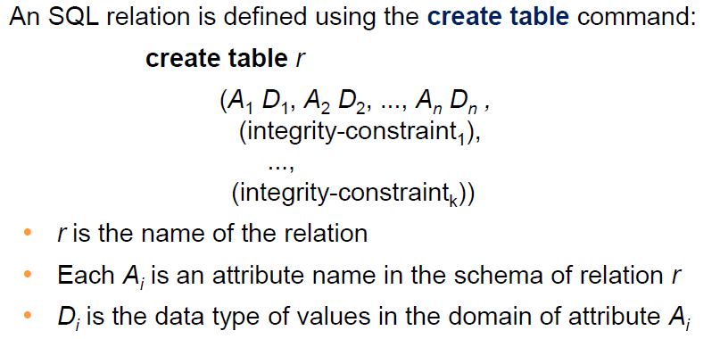
02
Create/Drop Table
Create table:
Drop table:
mysql> DROP TABLE table_name;
or:
mysql> DROP TABLE IF EXISTS table_name;

Slide 7
03
Database Index
Indexes are a powerful tool used in the background of a database to speed up querying. Indexes power queries by providing a method to quickly lookup the requested data.
Simply put, an index is a pointer to data in a table. An index in a database is very similar to an index in the back of a book.

Slide 8

04
Modify Table Structure
ALTER TABLE table_name Operations
mysql > alter table student add primary key (ID);
mysql> describe student;

Slide 9
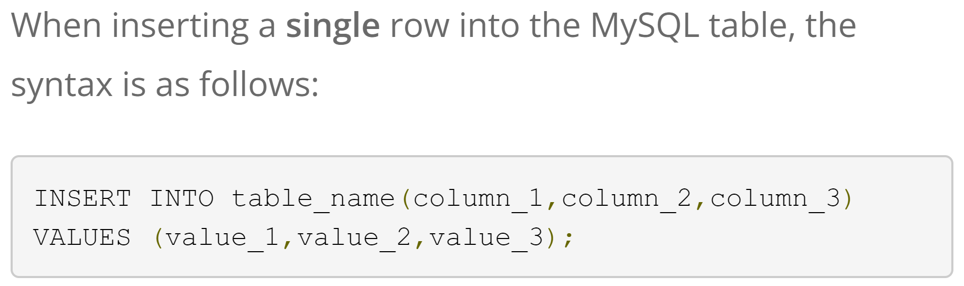
05
Insert Record
Method 2
INSERT INTO table_name SET col_name1=value1, col_name2=value2, col_name3=value3, …;

Slide 10

06
Update Record
UPDATE table_name
SET col_name1=value1, col_name2=value2, …
WHERE condition
Example:

Slide 11

07
Delete Record
Delete FROM table_name
WHERE condition
Example:
Delete FROM table_name;
Will delete ALL table_name records!
What about “truncate”?

Slide 12
08
Delete vs. Truncate
SQL Truncate command places a table and page lock to remove all records.
Delete command logs entry for each deleted row in the transaction log.
The truncate command does not log entries for each deleted row in the transaction log.
Delete command is slower than the Truncate command.

Slide 13
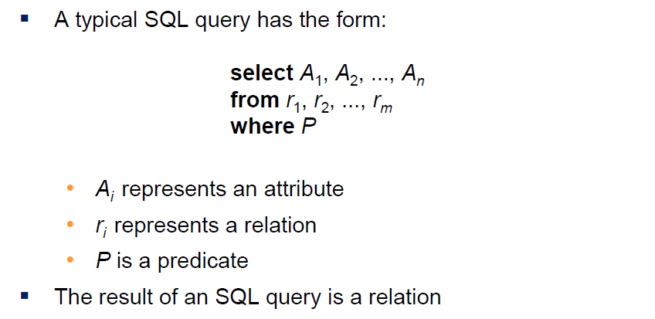
09
Querying data

Slide 14
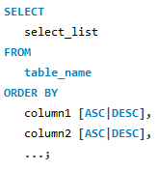
10
Sorting data
When you use the SELECT statement to query data from a table, the order of rows in the result set is unspecified. To sort the rows in the result set, you add the ORDER BY clause to the SELECT statement.
Syntax:

Slide 15
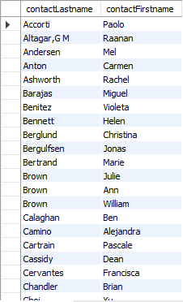
10
Sorting data
Example 1:
SELECT
contactLastname,
contactFirstname
FROM
customers
ORDER BY
contactLastname;

Slide 16
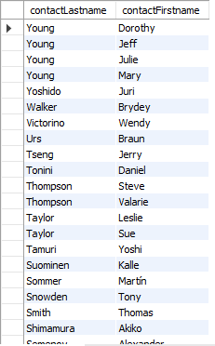
10
Sorting data
Example 2:
Using MySQL ORDER BY clause to sort the result set by multiple columns
SELECT
contactLastname,
contactFirstname
FROM
customers
ORDER BY
contactLastname DESC,
contactFirstname ASC;

Slide 17


11
SELECT DISTINCT
When querying data from a table, you may get duplicate rows. To remove these duplicate rows, you use the DISTINCT clause in the SELECT statement.
Example:
SELECT
lastname
FROM
employees
ORDER BY
lastname;
SELECT
DISTINCT lastname
FROM
employees
ORDER BY
lastname;

Slide 18

12
Alias for columns
Sometimes, column names are so technical that make the query’s output very difficult to understand. To give a column a descriptive name, you can use a column alias.
Example: The following statement selects the orders whose total amount is greater than 60000. It uses column aliases in GROUP BY and HAVING clauses.
SELECT
orderNumber `Order no.`,
SUM(priceEach * quantityOrdered) total
FROM
orderDetails
GROUP BY
`Order no.`
HAVING
total > 60000;

Slide 19
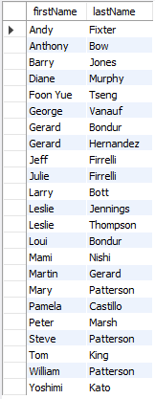
13
Alias for tables
You can use an alias to give a table a different name. You assign a table an alias by using the AS keyword as the following syntax:
table_name AS table_alias
Example:
SELECT
e.firstName,
e.lastName
FROM
employees e
ORDER BY e.firstName;

Slide 20
14
Inner Join
The INNER JOIN matches each row in one table with every row in other tables and allows you to query rows that contain columns from both tables.
The INNER JOIN is an optional clause of the SELECT statement. It appears immediately after the FROM clause.
If rows from both tables cause the join condition to evaluate to TRUE, the INNER JOIN creates a new row whose columns contain all columns of rows from the tables and includes this new row in the result set. Otherwise, the INNER JOIN just ignores the rows.
In case no row between tables causes the join condition to evaluate to TRUE, the INNER JOIN returns an empty result set. This logic is also applied when you join more than 2 tables.

Slide 21
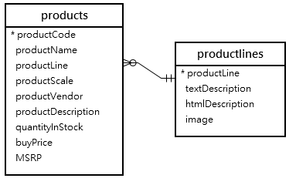
14
Inner Join
Example: Let’s look at the products and productlines tables in the sample database.
Suppose you want to get:
The productCode and productName from the products table.
The textDescription of product lines from the productlines table.
To do this, you need to select data from both tables by matching rows based on values in the productline column using the INNER JOIN clause as follows:

Slide 22
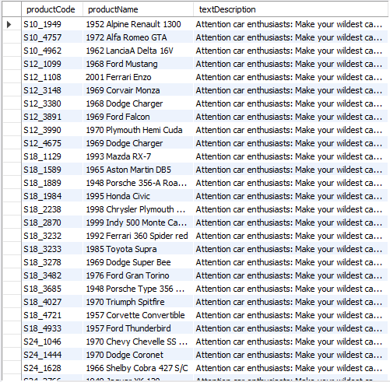
14
Inner Join
SELECT
productCode,
productName,
textDescription
FROM
products t1
INNER JOIN productlines t2
ON t1.productline = t2.productline;
Or we can write:
SELECT
productCode,
productName,
textDescription
FROM
products t1
INNER JOIN productlines t2
USING (productline);

Slide 23
15
Group by
The GROUP BY clause groups a set of rows into a set of summary rows by values of columns or expressions. The GROUP BY clause returns one row for each group. In other words, it reduces the number of rows in the result set.
In practice, we often use the GROUP BY clause with aggregate functions such as SUM, AVG, MAX, MIN, and COUNT. The aggregate function that appears in the SELECT clause provides the information of each group.

Slide 24
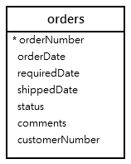
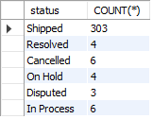
15
Group by
Example:
Suppose we want to group values of the order’s status, and their counts into subgroups, then we can write:
SELECT
status, COUNT(*)
FROM
orders
GROUP BY status;

Slide 25

16
Group by … having
The HAVING clause is often used with the GROUP BY clause to filter groups based on a specified condition. If you omit the GROUP BY clause, the HAVING clause behaves like the WHERE clause.
Example:
Suppose we want to group values of the order’s status into subgroups that the status names end with “ed”, then we can write:
SELECT
status, COUNT(*)
FROM
orders
GROUP BY status
having status like "%ed";

Slide 26
17
Subquery
A MySQL subquery is a query nested within another query such as SELECT, INSERT, UPDATE or DELETE. Also, a subquery can be nested within another subquery.
A MySQL subquery is called an inner query while the query that contains the subquery is called an outer query. A subquery can be used anywhere that expression is used and must be closed in parentheses.

Slide 27
17
Subquery
Exercise: Get the lastName and firstName of employees who work in the offices located in the USA.

Slide 28
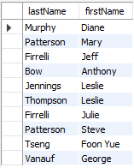
17
Subquery
Exercise: Get the lastName and firstName of employees who work in the offices located in the USA.
SELECT
lastName, firstName
FROM
employees
WHERE
officeCode IN (SELECT
officeCode
FROM
offices
WHERE
country = 'USA');

Slide 29
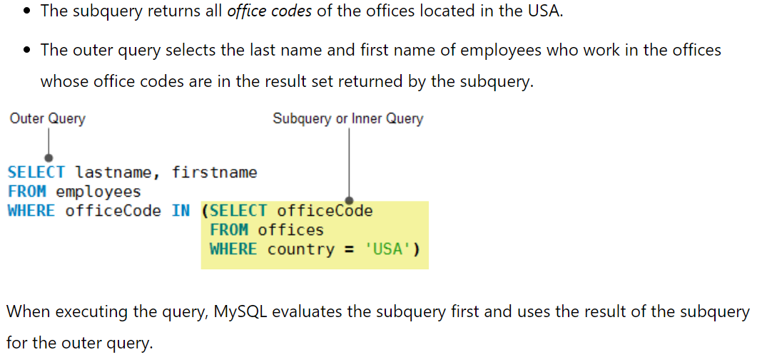
17
Subquery
In this example:

Slide 30

18
Subquery in FROM clause
When you use a subquery in the FROM clause, the result set returned from a subquery is used as a temporary table. This table is referred to as a derived table or materialized subquery.
Example: The following subquery finds the maximum, minimum, and average number of items in sale orders:
SELECT
MAX(items), MIN(ems), FLOOR(AVG(items))
FROMit
(SELECT
orderNumber, COUNT(orderNumber) AS items
FROM
orderdetails
GROUP BY orderNumber) AS lineitems;

Slide 31
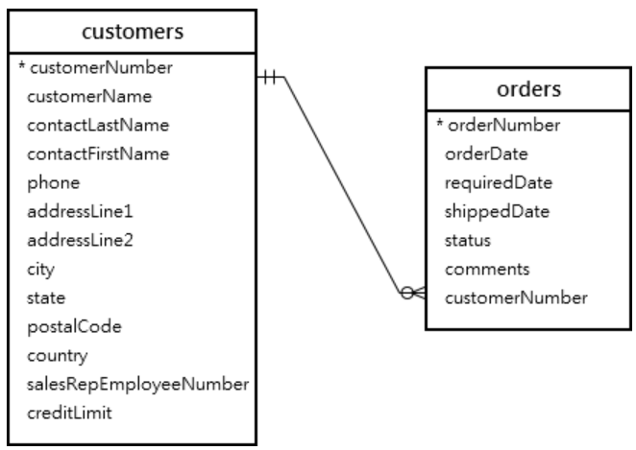
18
Exists
The EXISTS operator is a Boolean operator that returns either true or false.
It is often used to test for the existence of rows returned by the subquery.
Exercise: Consider the following customers and orders tables in the sample database. Find the customer who has at least one order.

Slide 32
18
Exists
Solution:
SELECT
customerNumber, customerName
FROM
customers
WHERE
EXISTS(
SELECT
1
FROM
orders
WHERE
orders.customernumber = customers.customernumber);
In this example, for each row in the customers table, the query checks the customerNumber in the orders table. If the customerNumber, which appears in the customers table, exists in the orders table, the subquery returns the first matching row. As a result, the EXISTS operator returns true and stops examining the orders table. Otherwise, the subquery returns no row and the EXISTS operator returns false.

Slide 33
19
Exists vs. IN
We can rewrite the solution by using IN:
SELECT
customerNumber,
customerName
FROM
customers
WHERE
customerNumber IN (
SELECT
customerNumber
FROM
orders);

Slide 34
19
Exists vs. IN
In this case, the query that uses the EXISTS operator is much faster than the one that uses the IN operator. // The reason is that the EXISTS operator works based on the “at least found” principle. The EXISTS stops scanning the table when a matching row found. // On the other hands, when the IN operator is combined with a subquery, MySQL must process the subquery first and then uses the result of the subquery to process the whole query.
How to judge which one is faster?
The general rule of thumb is that if the subquery contains a large volume of data, the EXISTS operator provides better performance. // However, the query that uses the IN operator will perform faster if the result set returned from the subquery is very small.

Slide 35
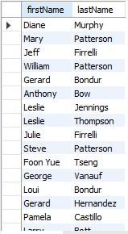
20
Union
MySQL UNION operator allows you to combine two or more result sets of queries into a single result set. The following illustrates the syntax of the UNION operator.
Example:
Suppose that you want to combine the first name and last name of employees and customers into a single result set, you can use the UNION operator as follows:
SELECT
firstName, lastName
FROM
employees
UNION
SELECT
contactFirstName, contactLastName
FROM
customers;

Slide 36
Thank you!

